Slide 1
E-Commerce Analysis
Abdelrahman mohmaed

Slide 2
Structure
Dataset: E-Commerce Dataset
Data source: Flat File (CSV)
Dimensions: 9994 rows, 21 Columns
Audience: Stakeholders

Slide 3
Requirements
Track sales Trend through period 2018-2021
Analyze Customers behavior (Churn/Retained)
Do RFM Segmentation Analysis
Analyze most profitable Products

Slide 4
Issues In Dataset
First row data have Inconsistent structure (Not follow other data structure)
Decided To Terminate first ROW_ID= 1
There is Some Inconsistent Customer Name In Many rows like
Decided To Do Nothing
According To Other Rows With Same Customer ID Shows Only Customer Name is Wrong and Other row features Seems good and Problem Solved In Model (Treated With ID’s)
City Burlington, In State Vermont Have No Postal Code But it Used in Model
Decided To Fill With Right Values
Row ID | Order ID | Customer ID
2 | CA-2020-152156 | CG-12520
10,11 | CA-2018-115812 | BH-11710
13 | CA-2021-114412 | AA-10480

Slide 5
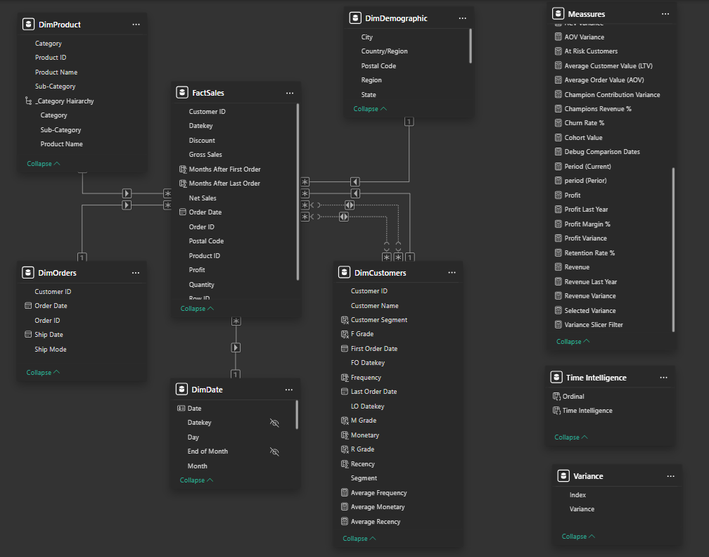
Data Model (Star Schema)

